Slide 1
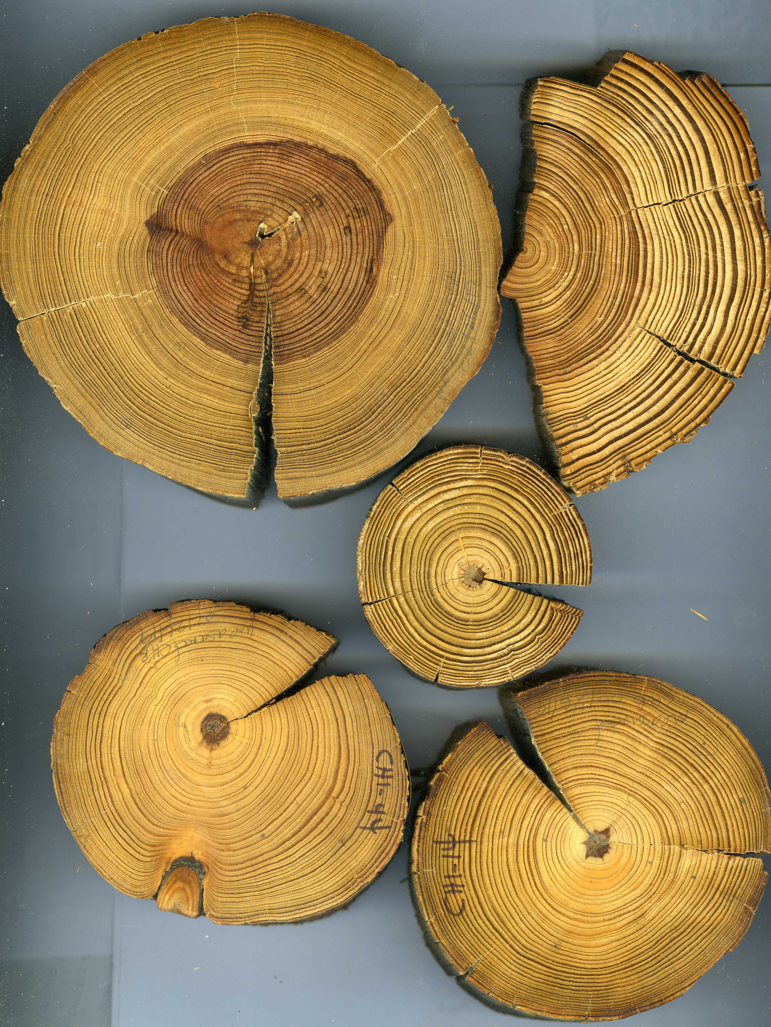
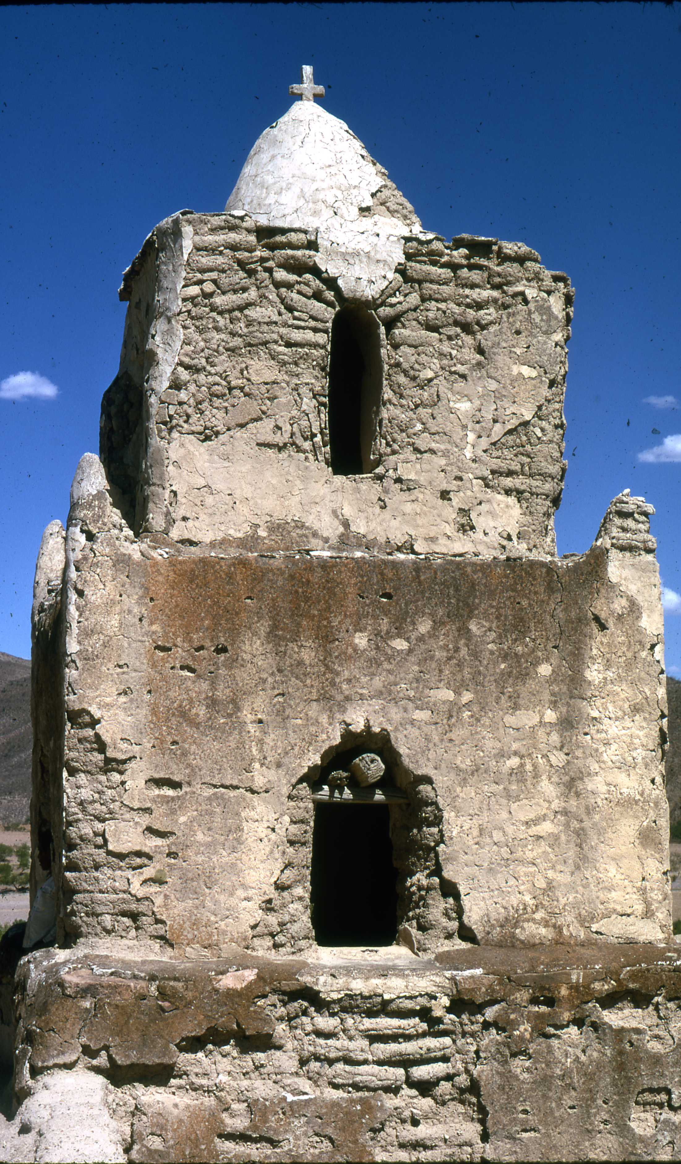
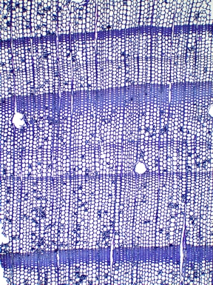
CNH2-L Cultural, social, and economic responses and adaptations to a semi-arid environment over the past millennium.
Proposal organizational meeting

Slide 2

Project proposal from the tree-ring perspective
Historical overview, material available, and some preliminary data

Slide 3
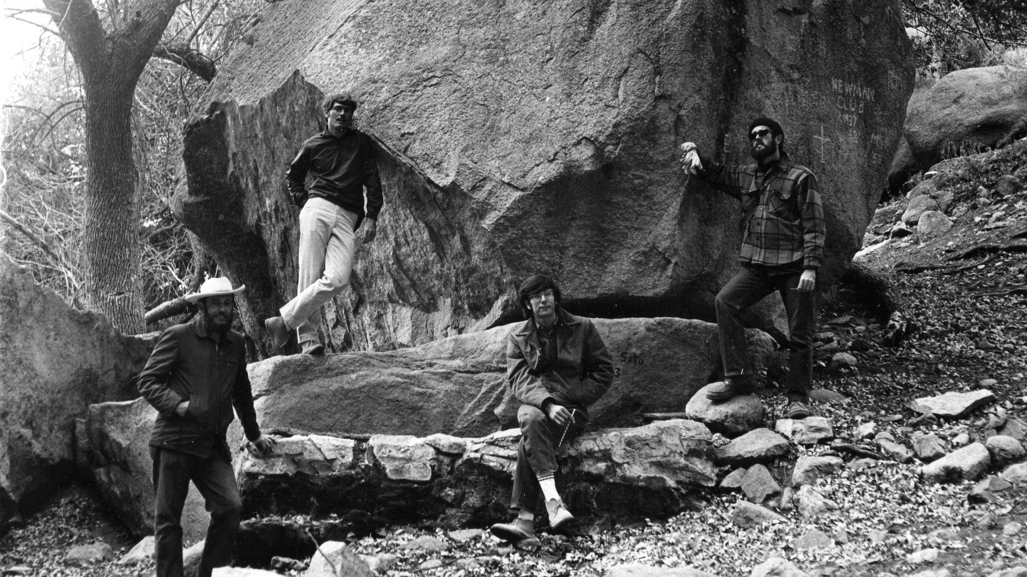
Marv Stokes, Tom Naylor, Gene Paull, and Barney Burns in the Organ Mountains
“Mexican Tree-Ring Project” ca 1973

Slide 4
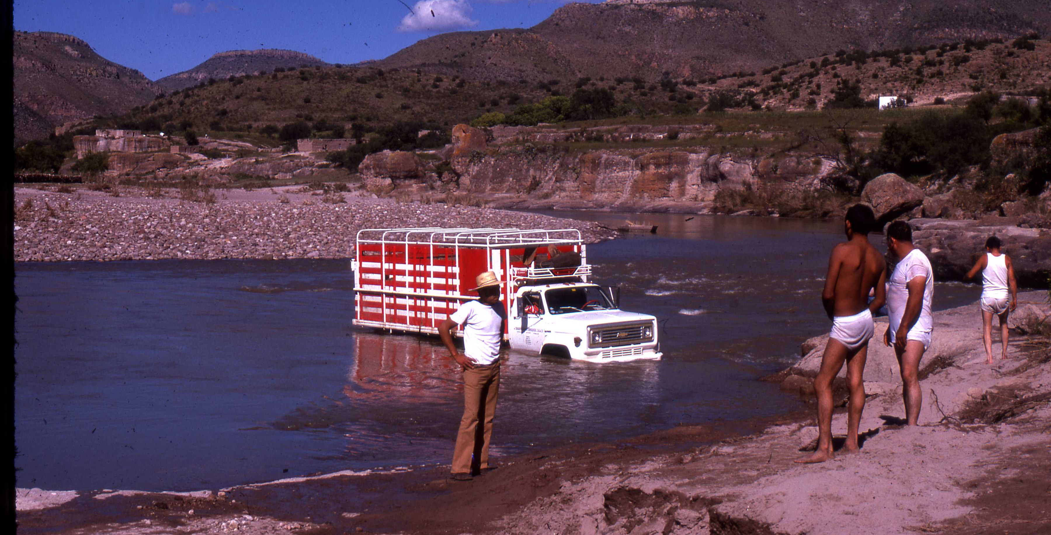
Sampling for the Mexican Tree-ring Project, 1974

Slide 5
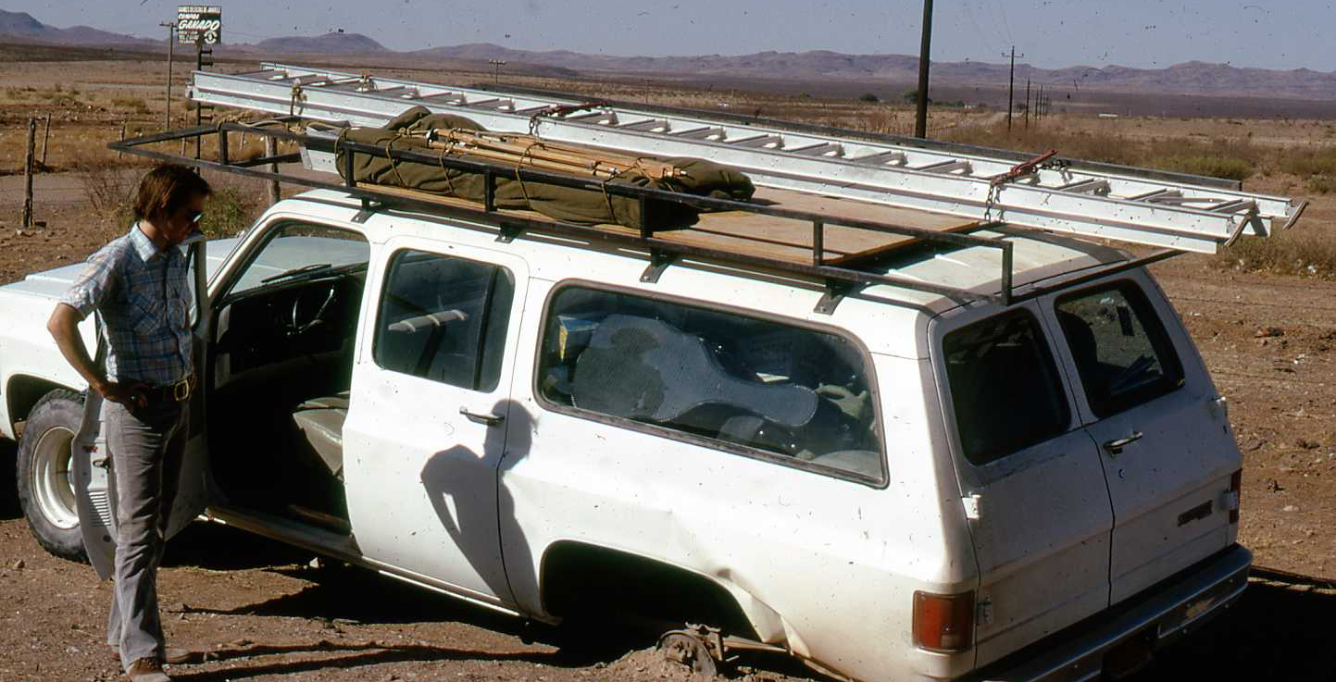
Sampling for the Mexican Tree-Ring Project, 1974

Slide 6
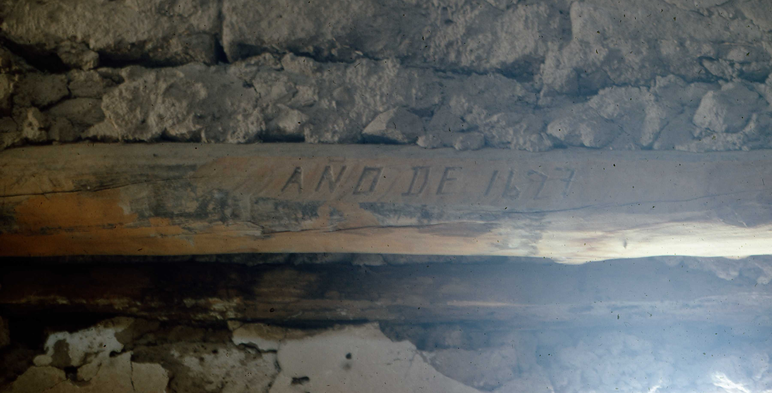
Date inscription on a church roof beam.

Slide 7

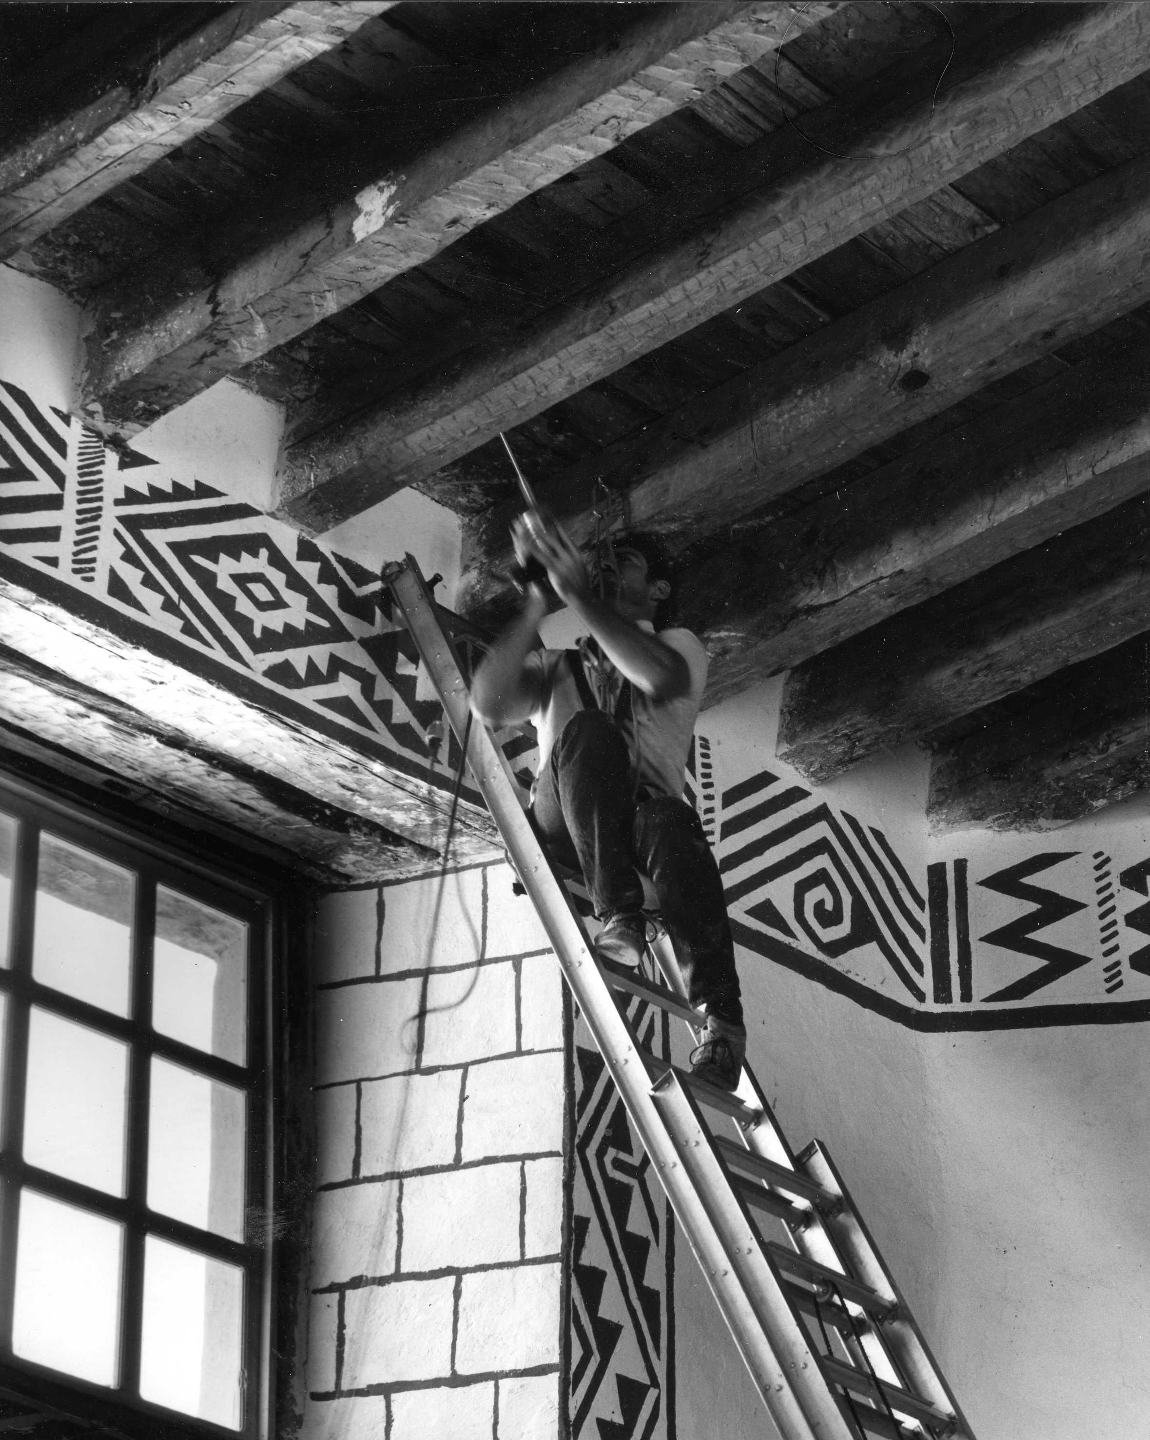
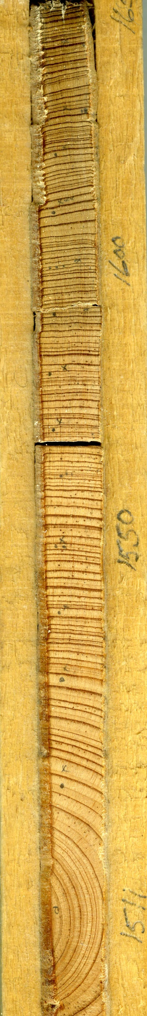
Tom Naylor taking a core sample
from a ceiling joist in Cusarare
church, Chihuahua, Mexico,
June 1976 for the Mexican
Tree-Ring Project

Slide 8
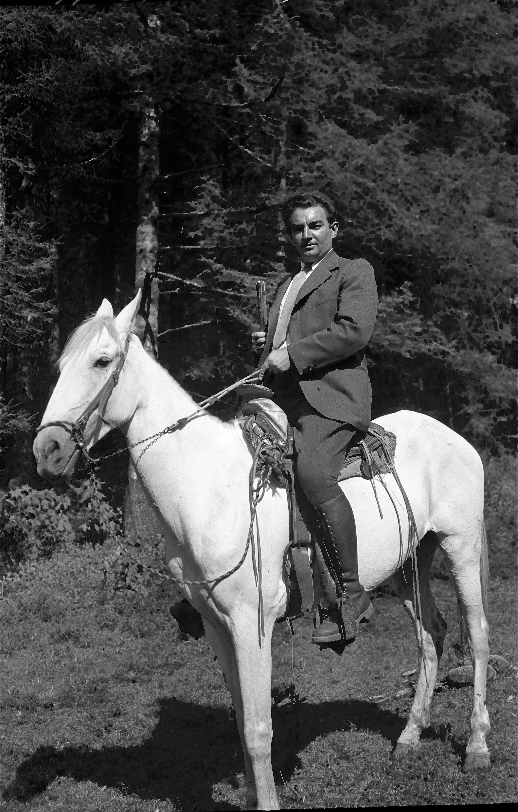
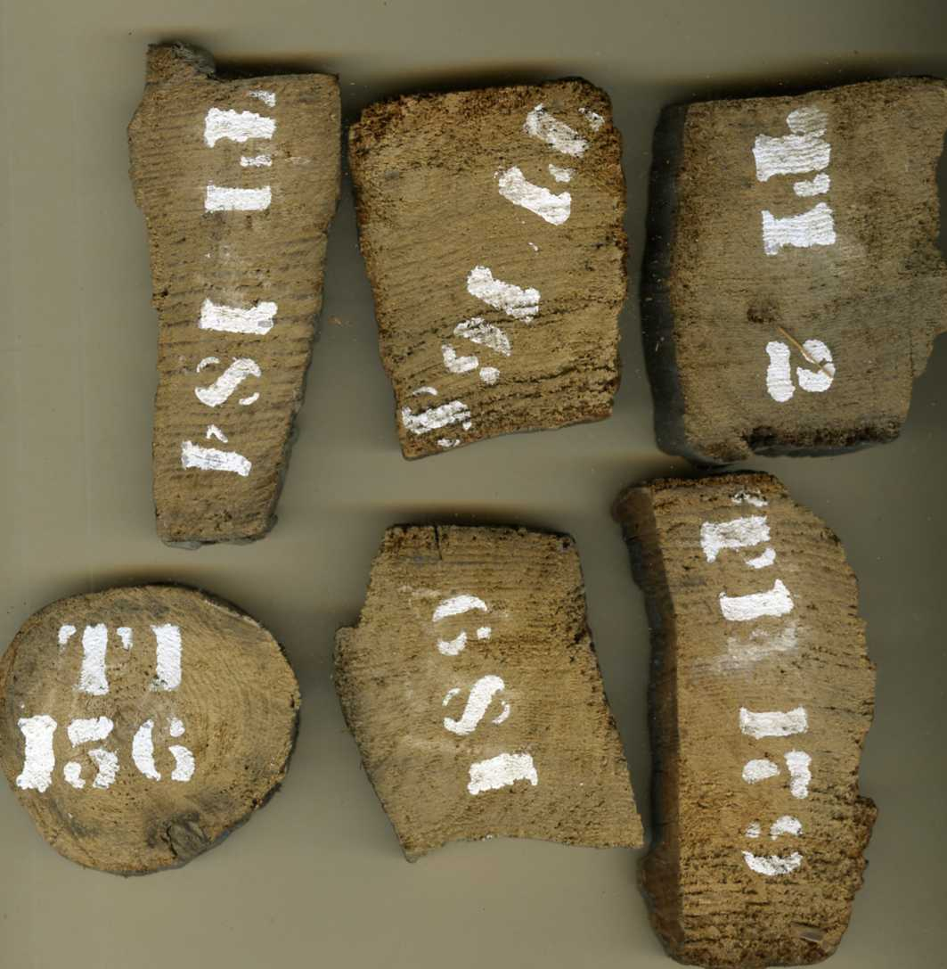
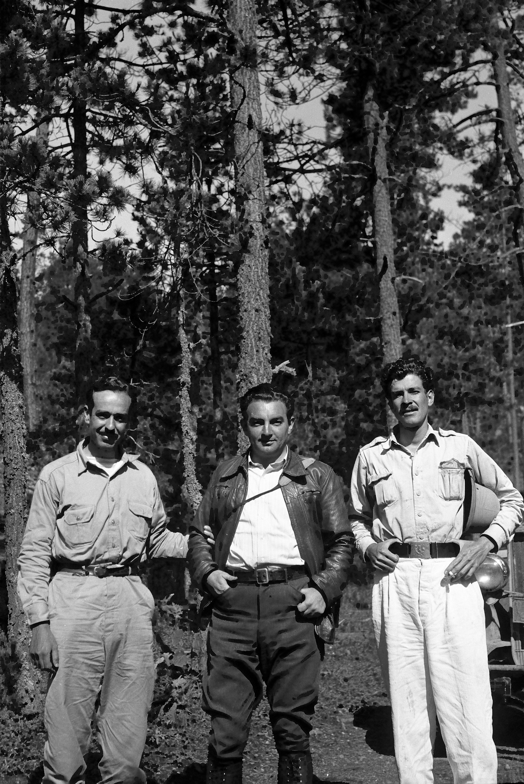
Ed Schulman
Tree-ring investigations in Mexico
1943

Slide 9

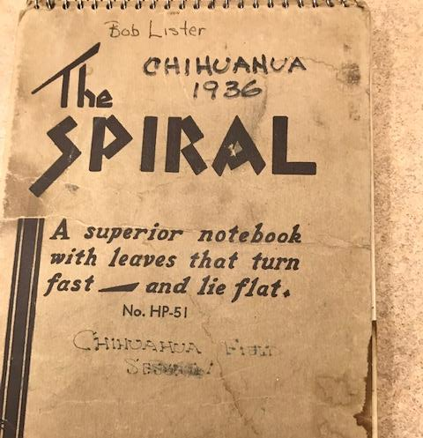
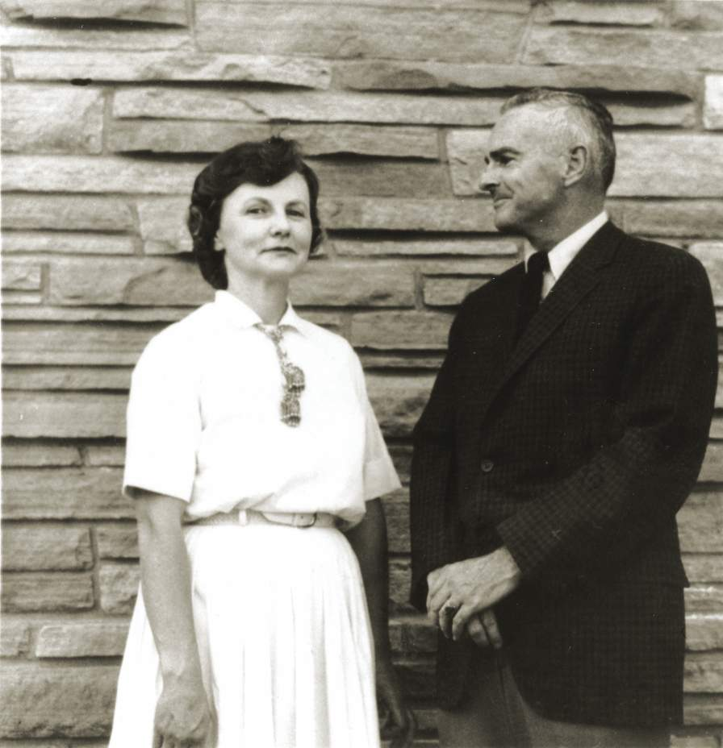
Florence and Robert Lister
Archaeology in Chihuahua

Slide 10

Bob lister and others collected archaeological wood samples from numerous sites in the northern Sierra Madre

Slide 11
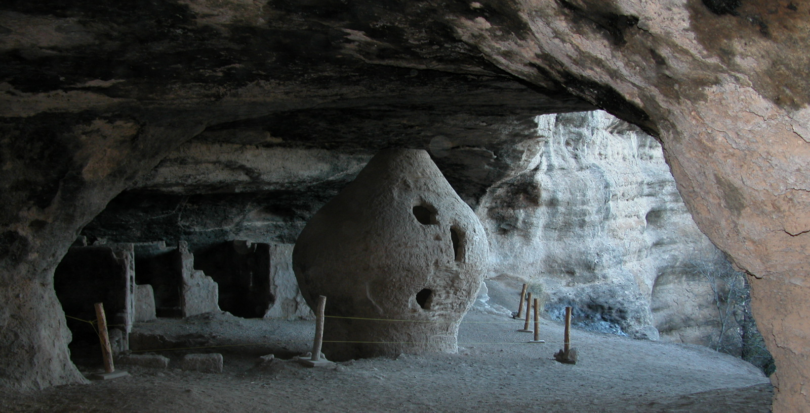
Olla Cave, Chihuahua

Slide 12
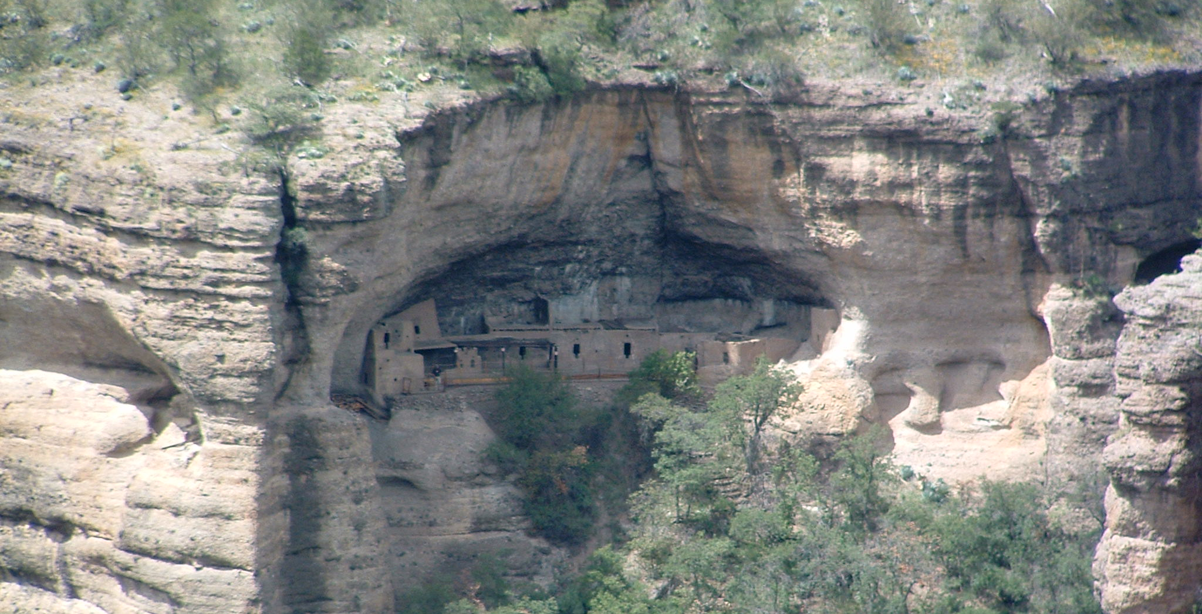
Cuaranta Casitas, Chihuahua

Slide 13
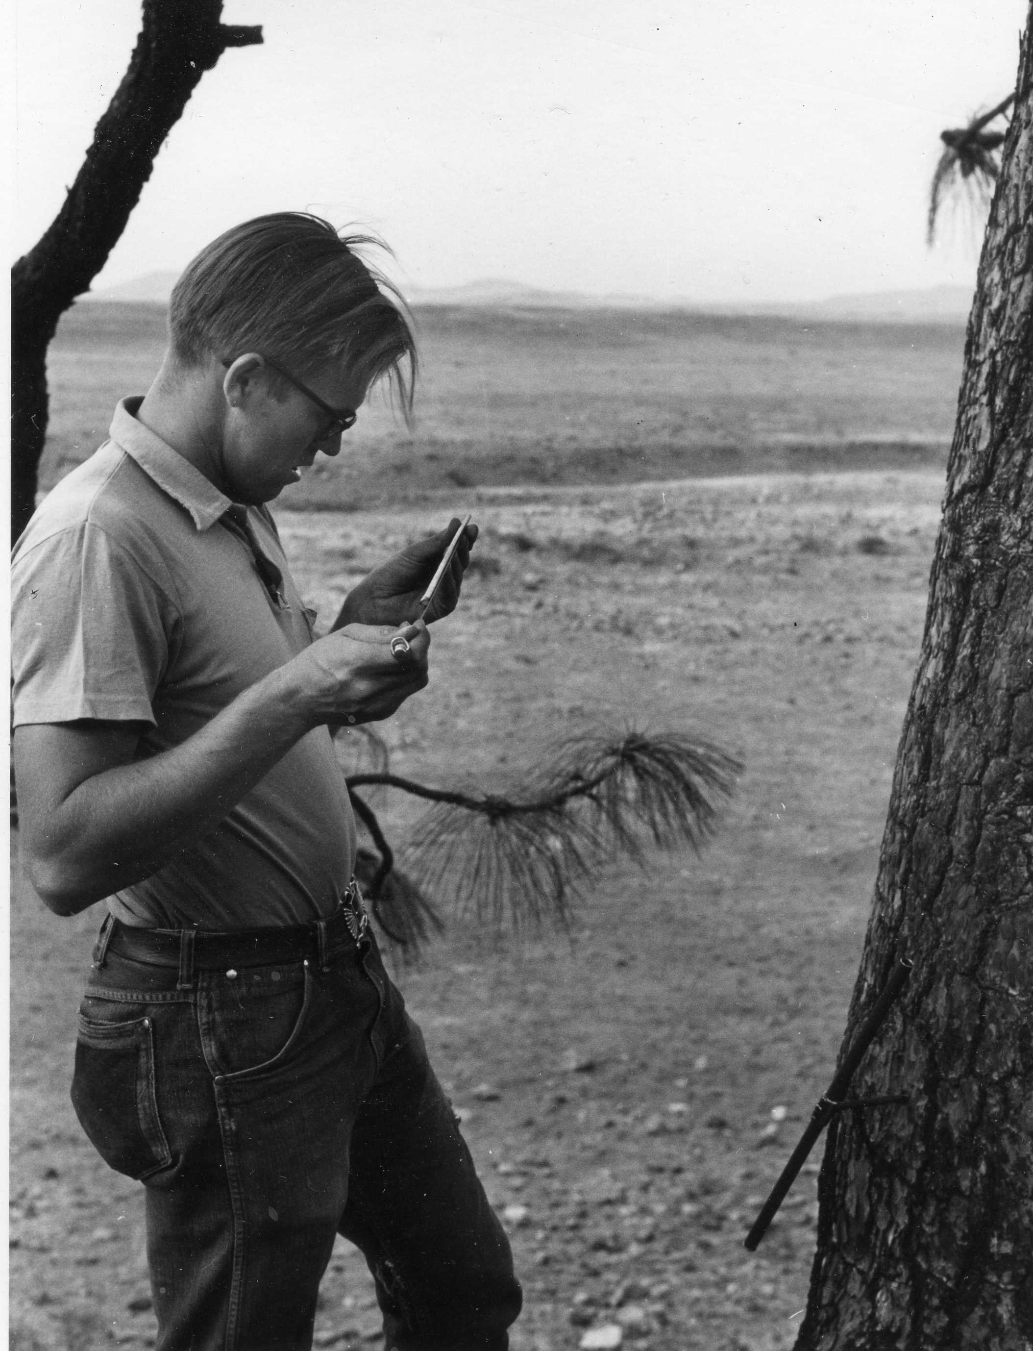
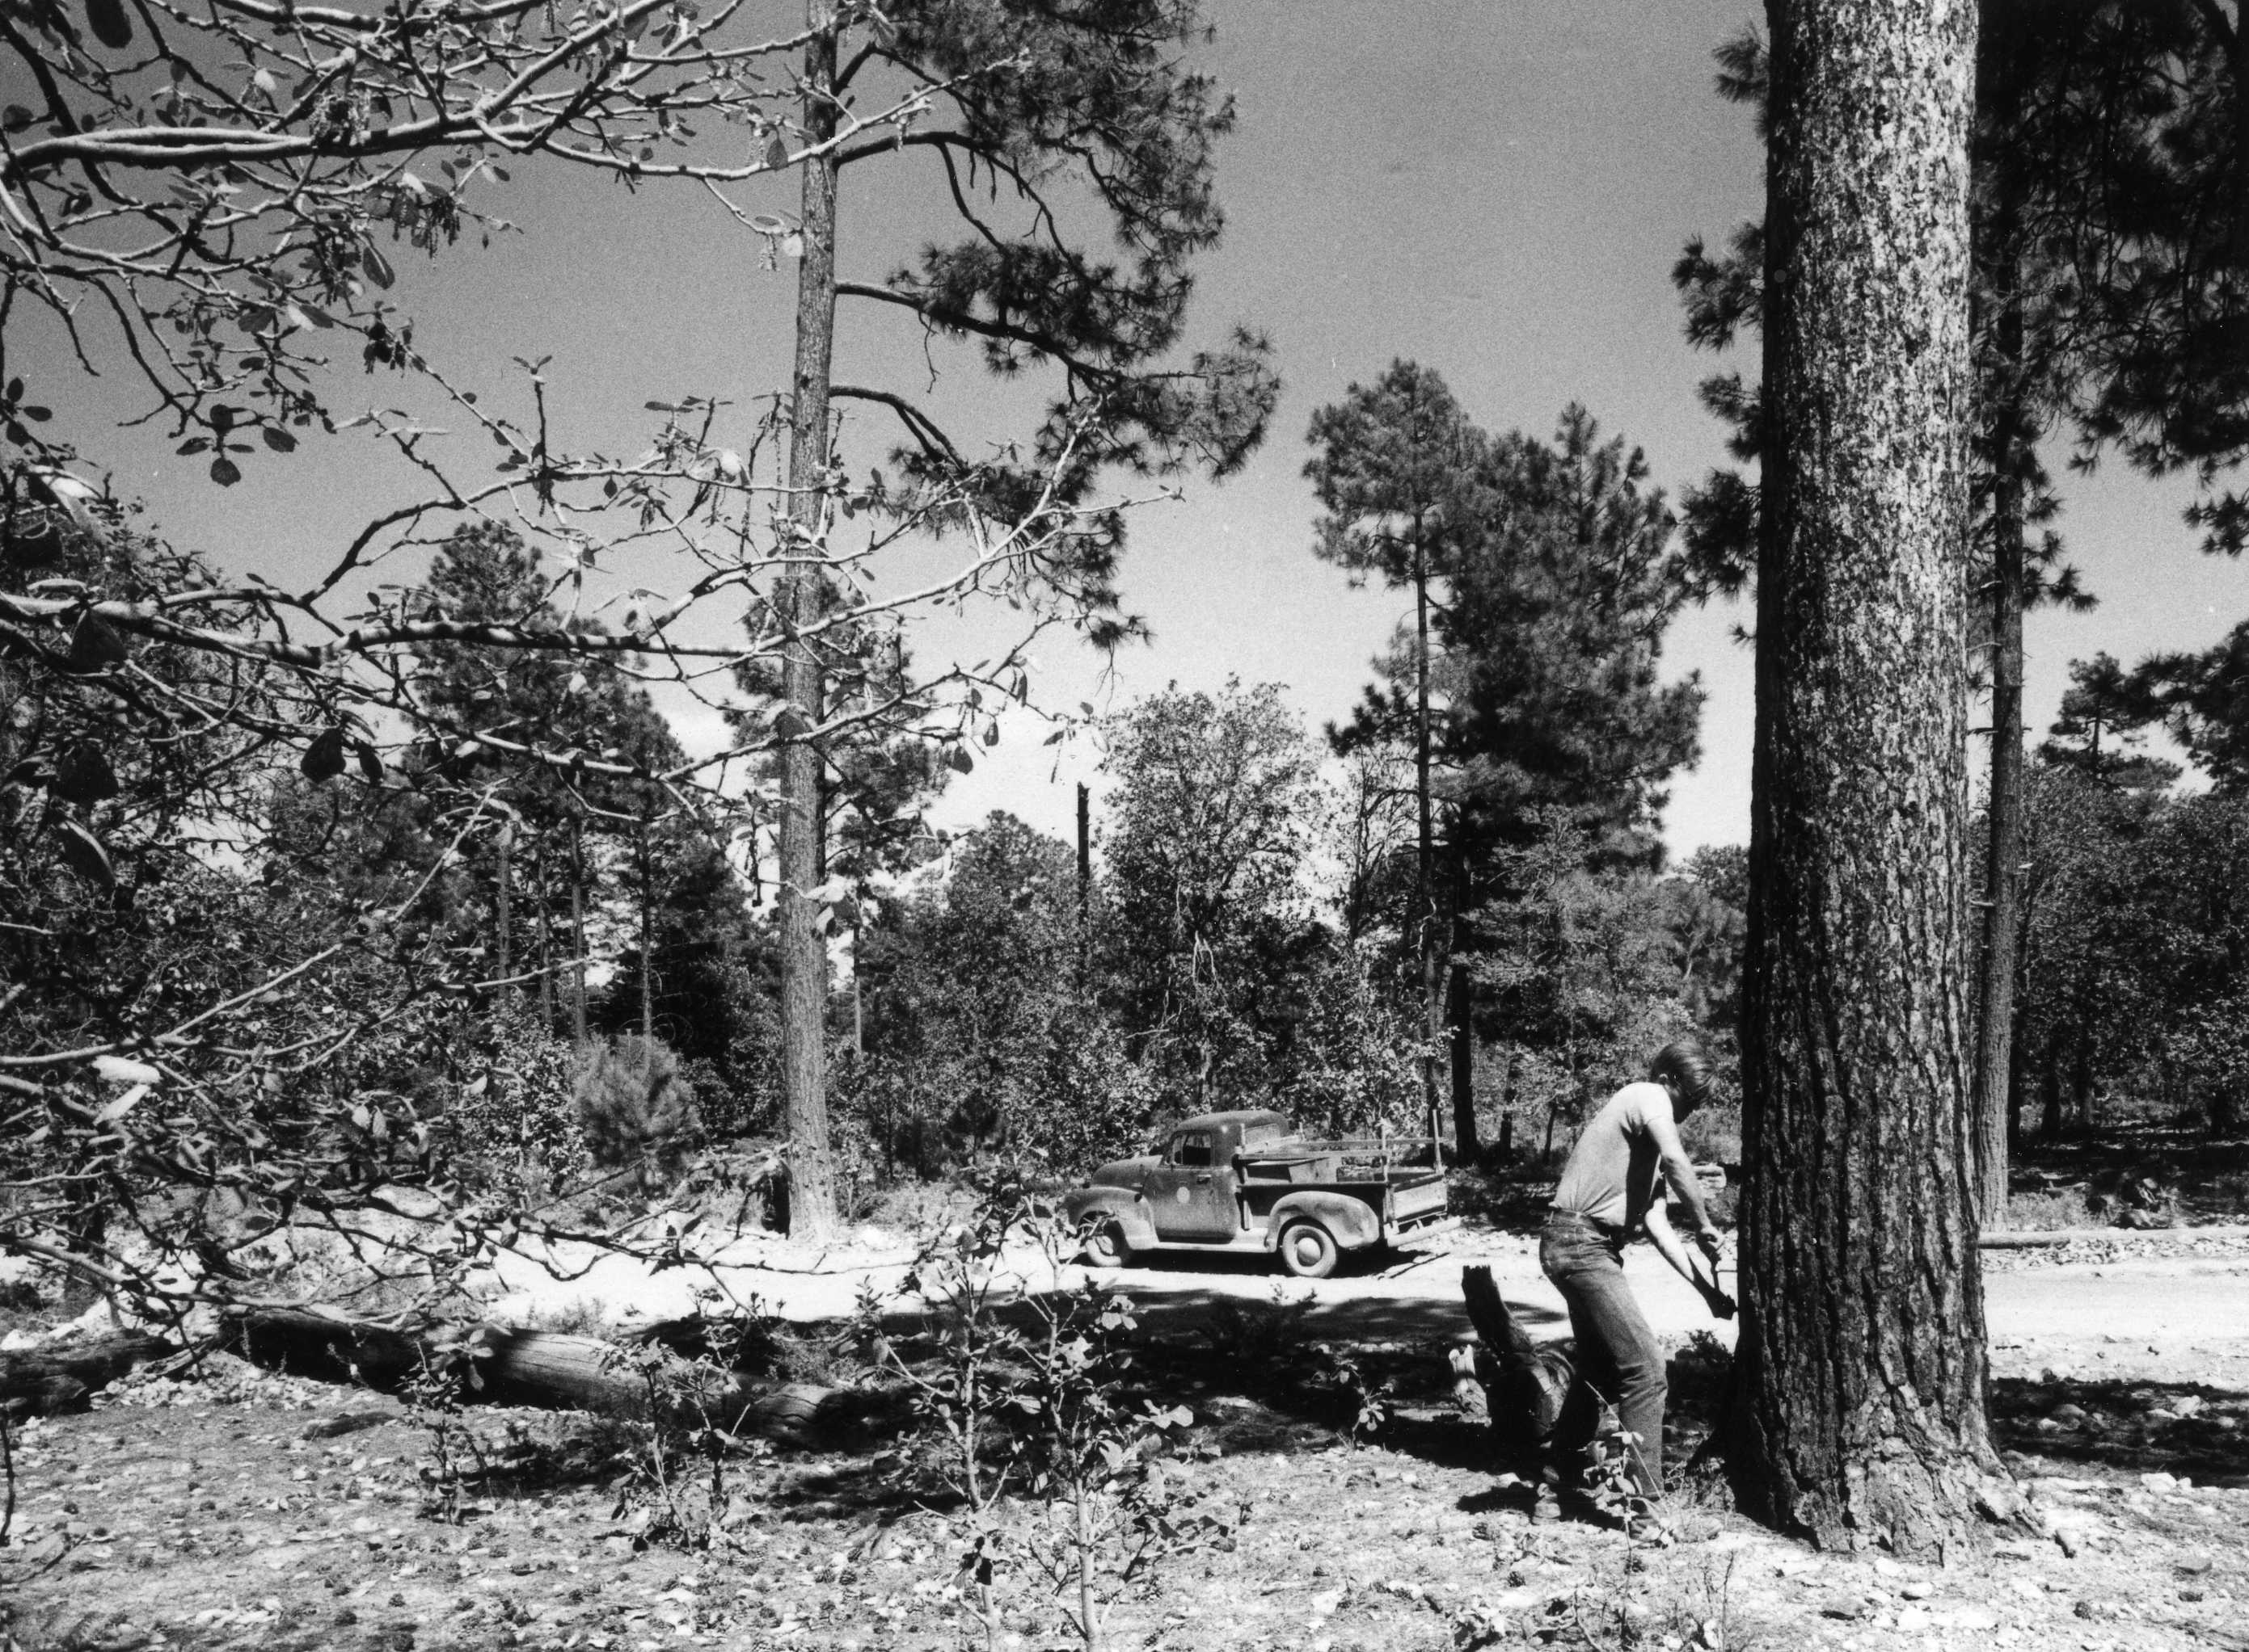
Tom Harlan, 1961, sampling living trees for the Casas Grandes project.

Slide 14
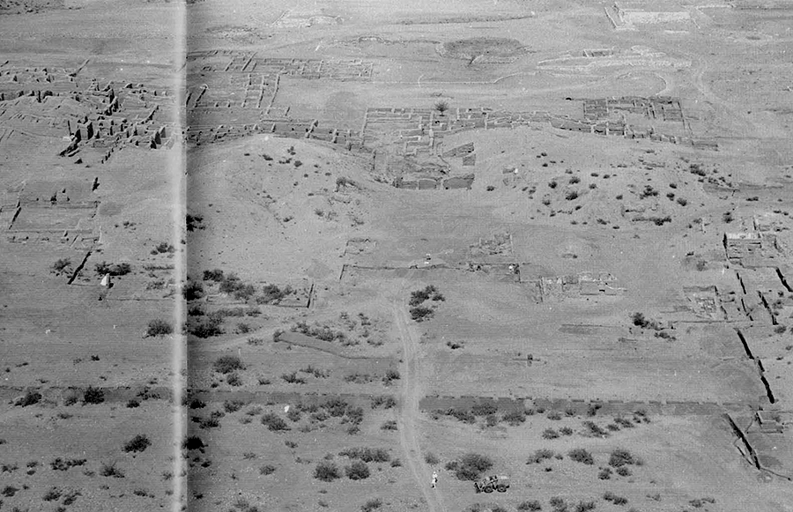
Paquime ruin, Chihuahua

Slide 15
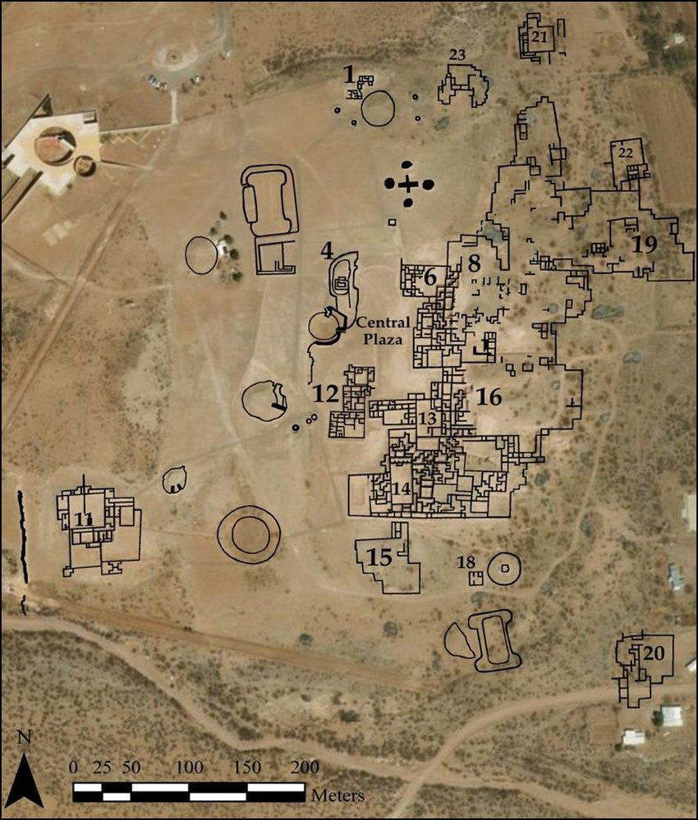
Reconstruction of the
Paquime archaeological site
excavated by Charles Di Peso
and the Amerind Foundation
between 1958 and 1962

Slide 16
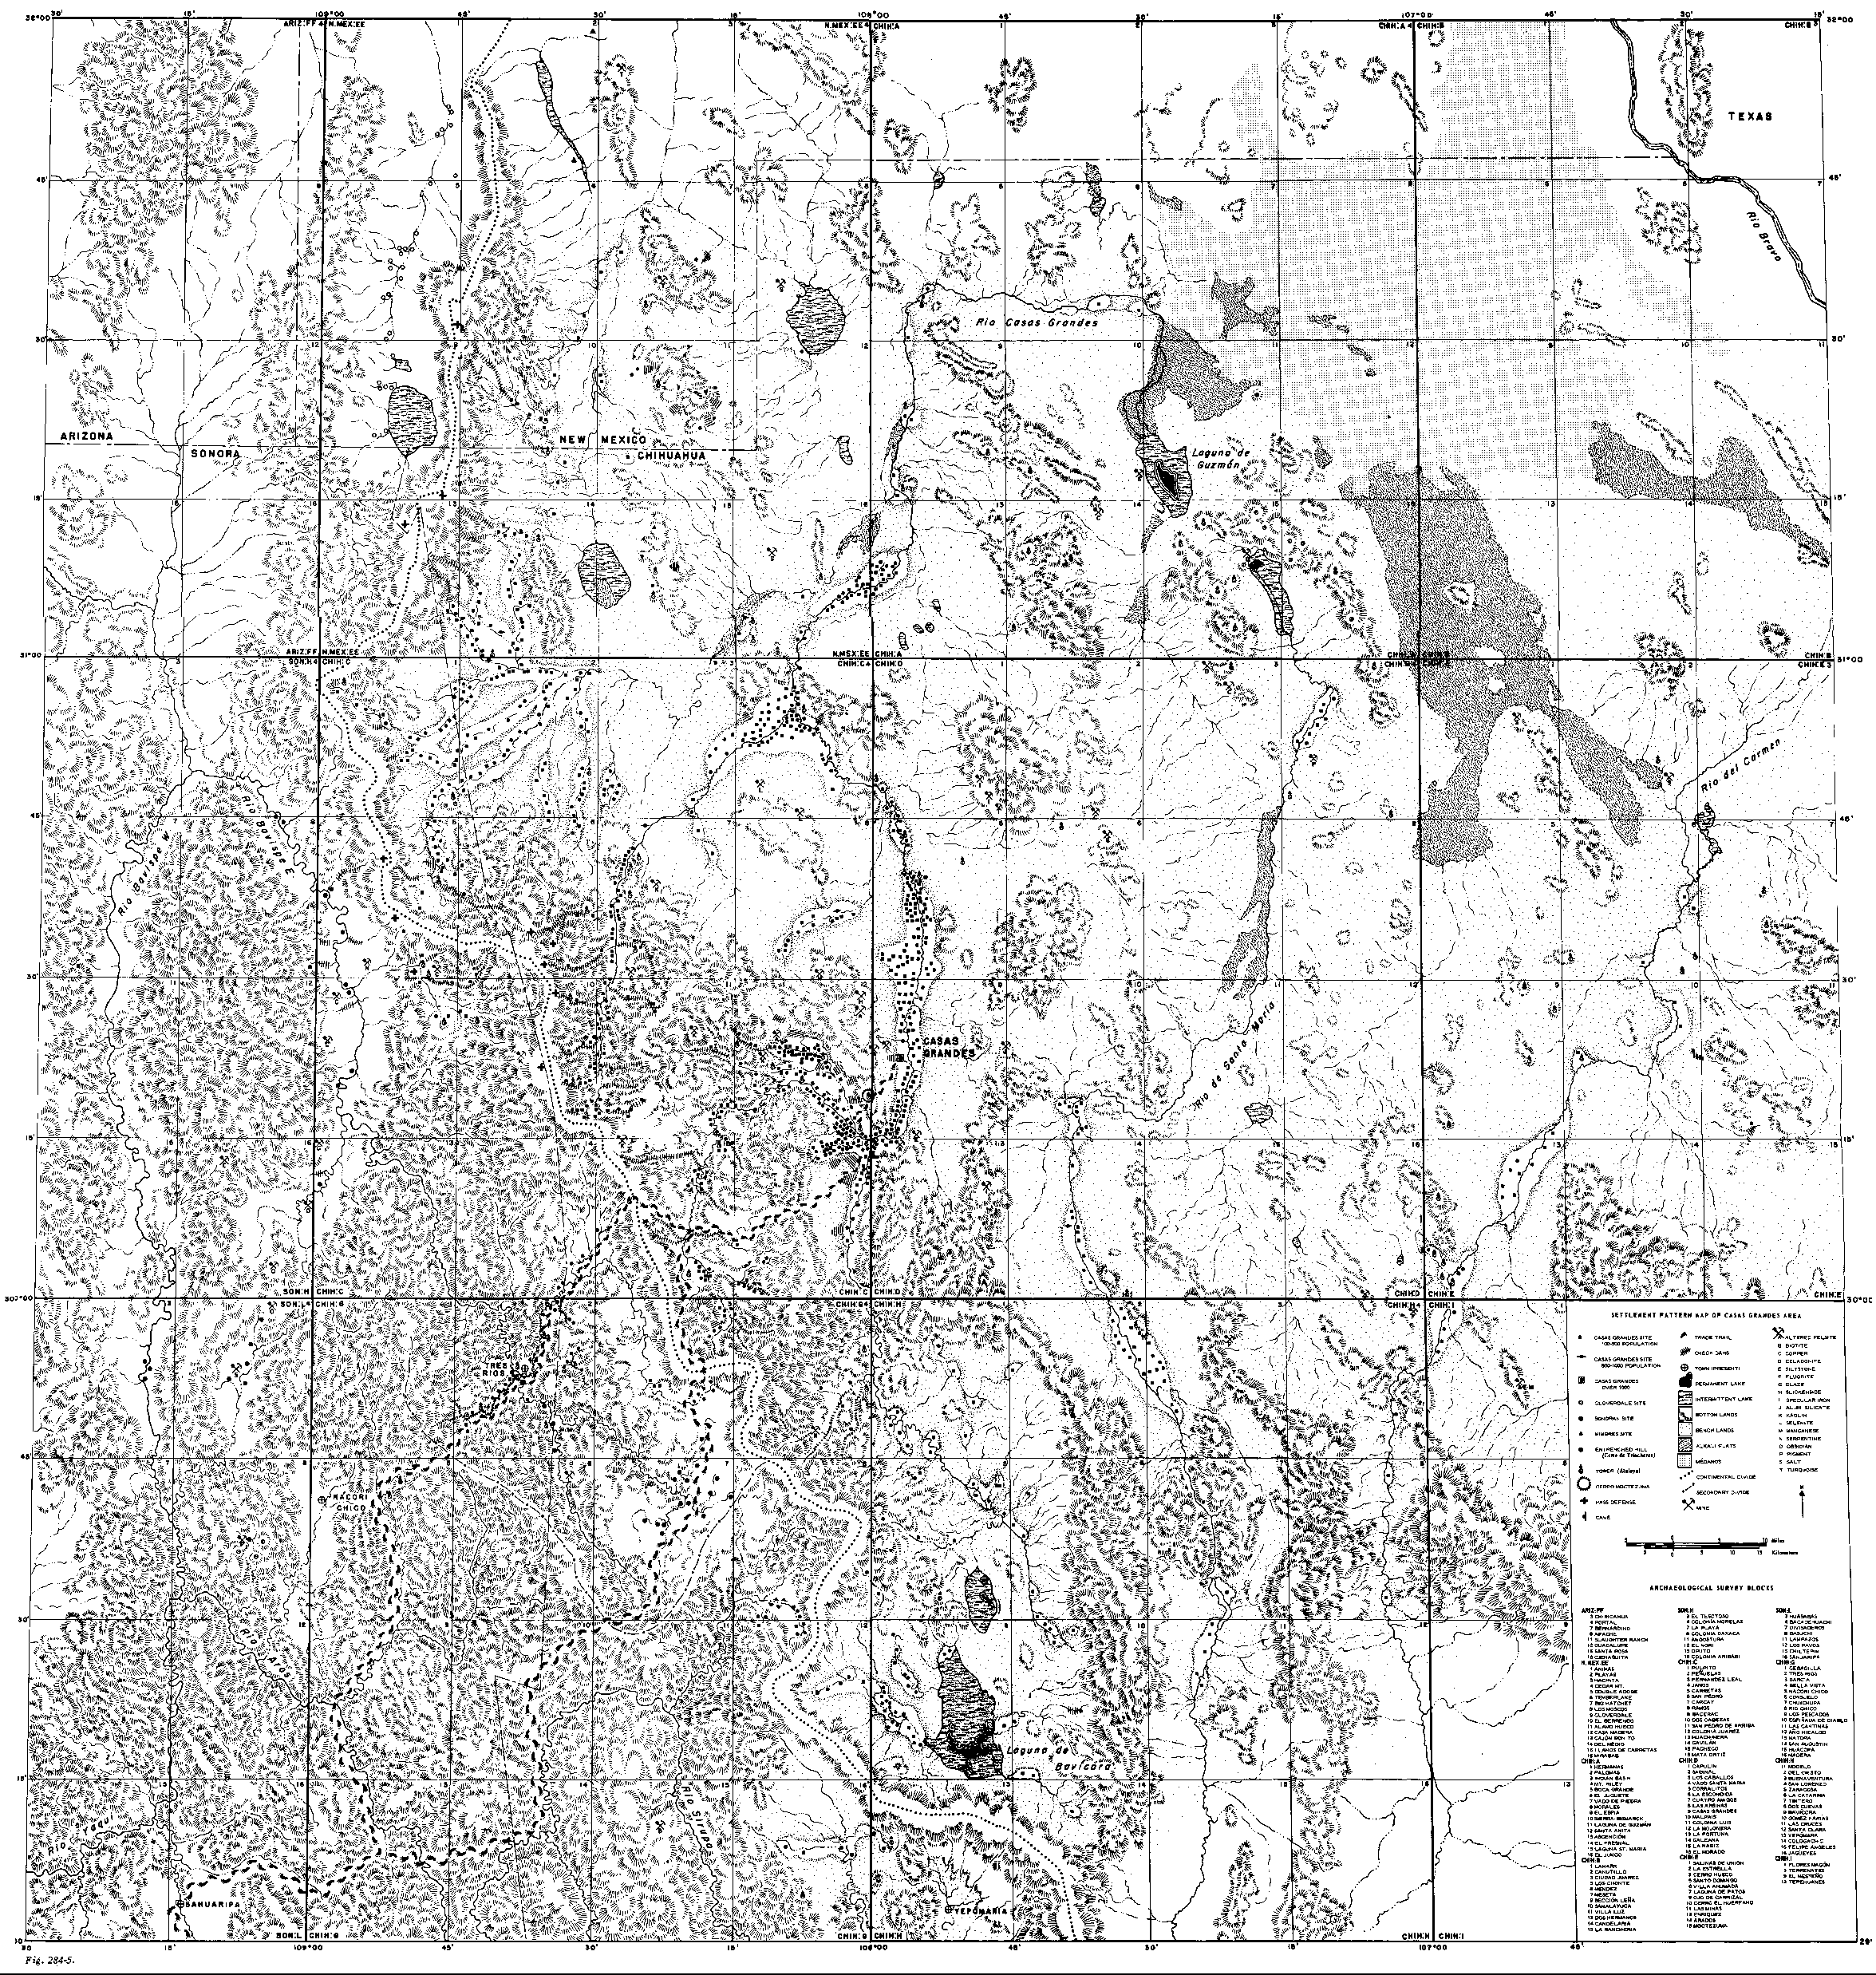
Map of archaeological
sites and features from
Di Peso, 1974, fig. 284,vol 5
Casas Grandes
(Paquime)
Map notes trails and
trinchera (check dam) systems,
as well as caves, villages and
home sites.

Slide 17
Mexico Tree-Ring Project 1973-1976
  Collected around 1,100 samples from ~50 churches and historic buildings in Chihuahua, Sonora, Sinaloa, and Durango
  Collected cores from living trees at 23 sites in the surrounding mountains
EB Sayles collected samples from several archaeological sites in 1933
Robert Lister collected samples from perhaps a dozen archaeological sites in 1936 and cored trees at one site
Deric Nusbaum collected samples from 9 or 10 archaeological sites and cored trees along the way in 1941
Charles Di Peso excavated the Casas Grandes ruins in the late 1950s and early 1960s recovering around 400 wood and charcoal samples
Naylor, Burns, and Harlan collected some additional material in the late 1960s and early 1970s
Beth Bagwell, Jupiter Martinez, Tom Windes, and Ron Towner collected several hundred additional samples in the early 2000s
Total number of archaeological samples is perhaps 1,200 or more

Slide 18
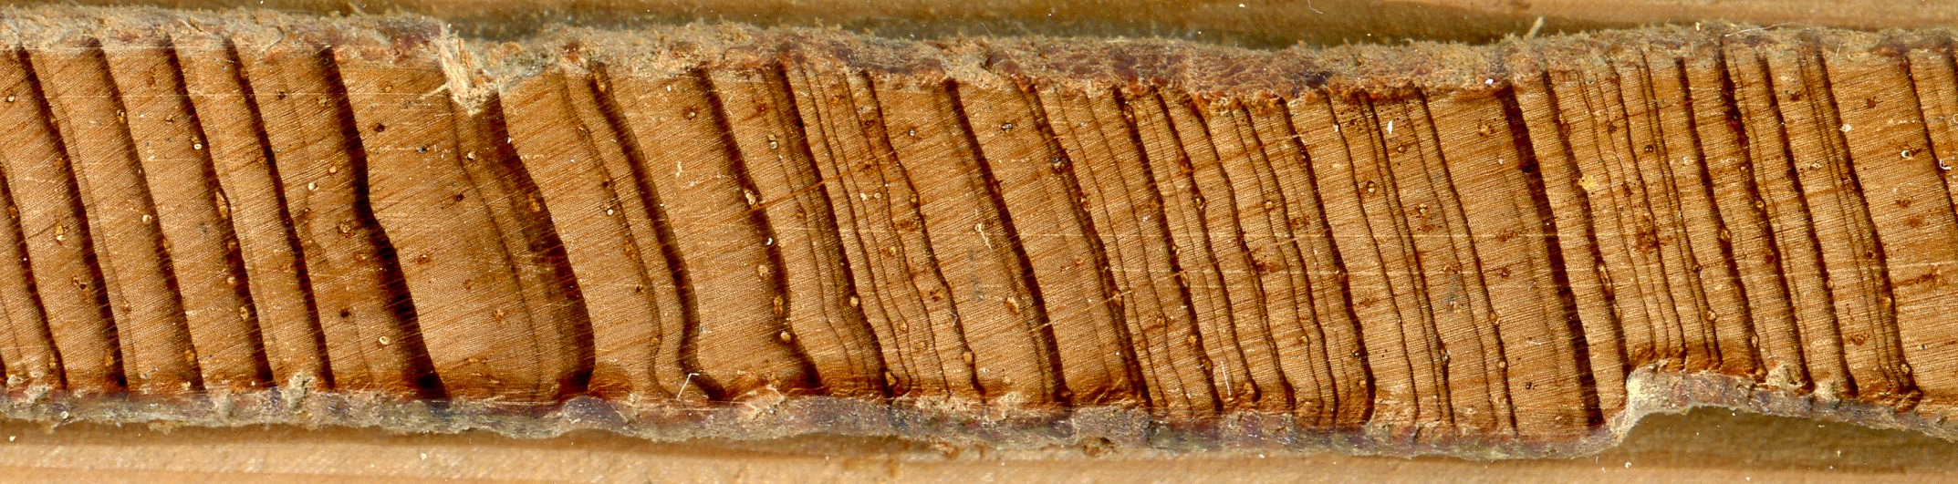
From the various collection efforts less than 10% of the samples from archaeological sites and historic buildings were dated, mainly because it was difficult to understand the growth rings, and the lack of well dated comparative material.

Slide 19
However, chronologies from living trees were developed and over the years the have become more numerous and covered more geographic area and more species.
In 1963 Stuart Scott completed his dissertation with dates for around 50 beams from Casas Grandes. By using a computer program to compare his chronology from the ruins to chronologies from Flagstaff Az and Santa Fe NM his sequence was dated to the period 850 to around 1260 AD.
Since this time long tree-ring chronologies have been developed much closer to the international border and the original dates confirmed. Additional statistical tools have been developed and comparative material is now available that was lacking before so…

Slide 20
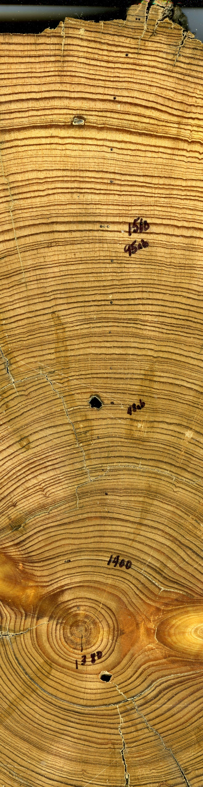
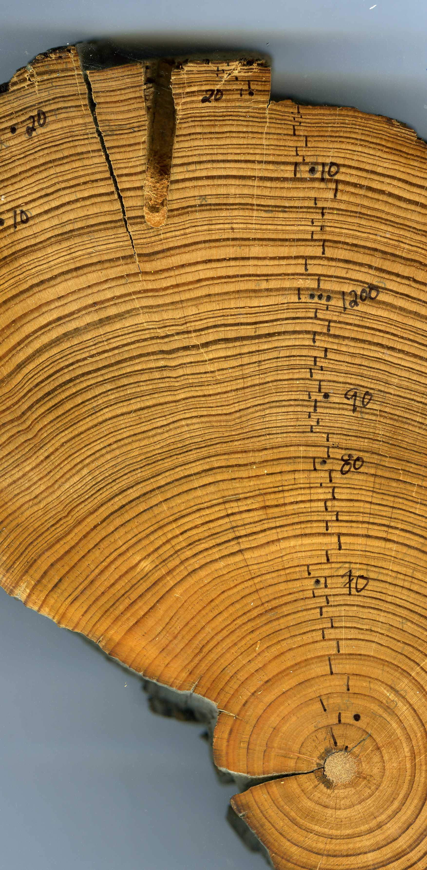
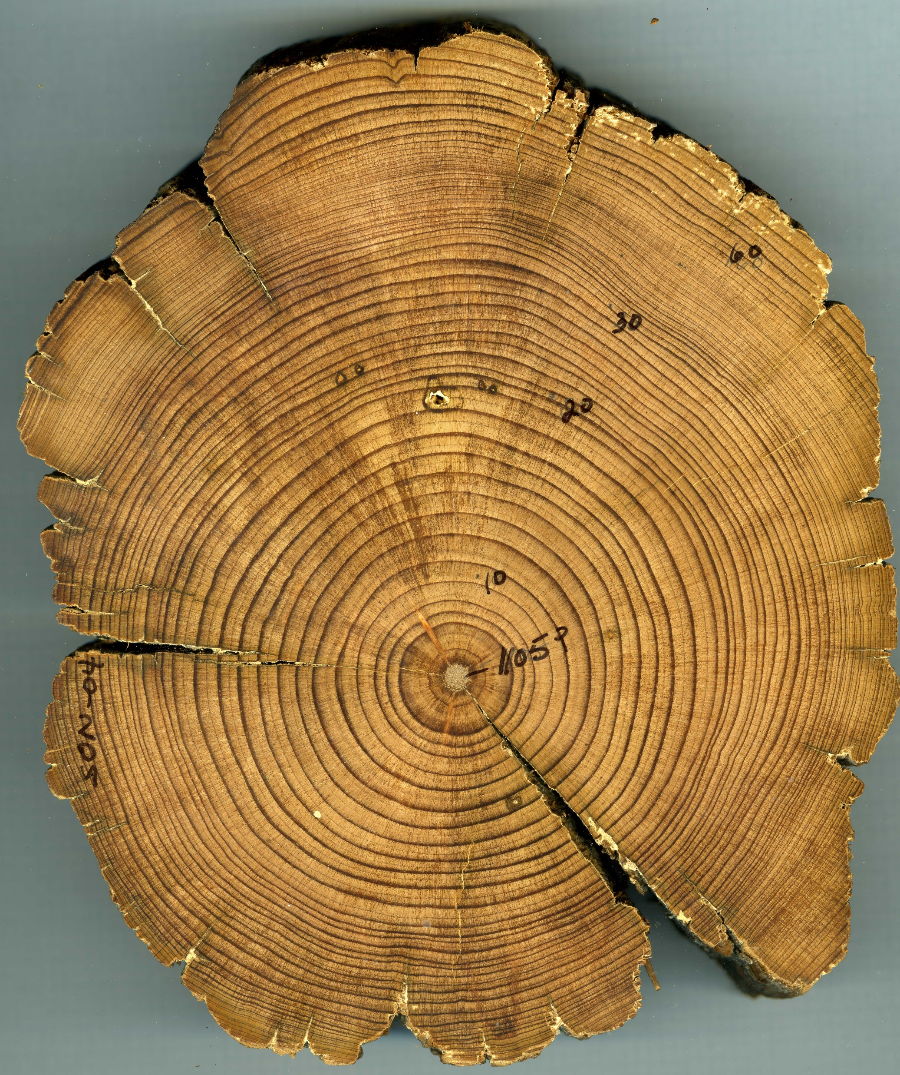
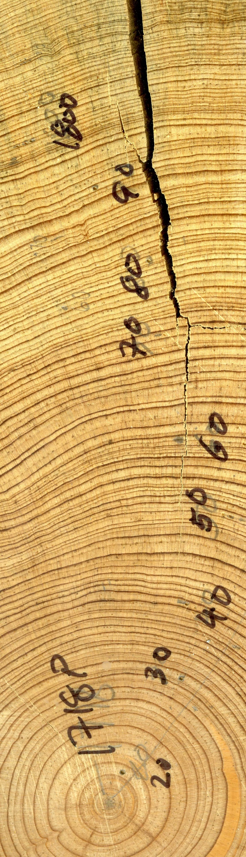
…a good portion of this material can now be reliably cross-dated:

Slide 21
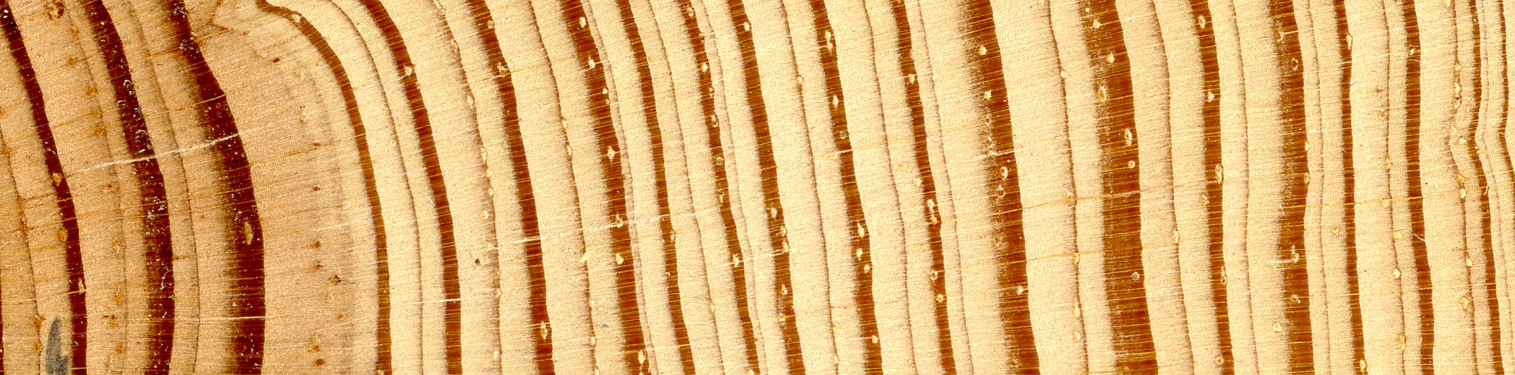
…and provide a clear record of both winter/spring and summer precipitation over the past 1,000 years
Winter/spring
Summer/monsoon

Slide 22
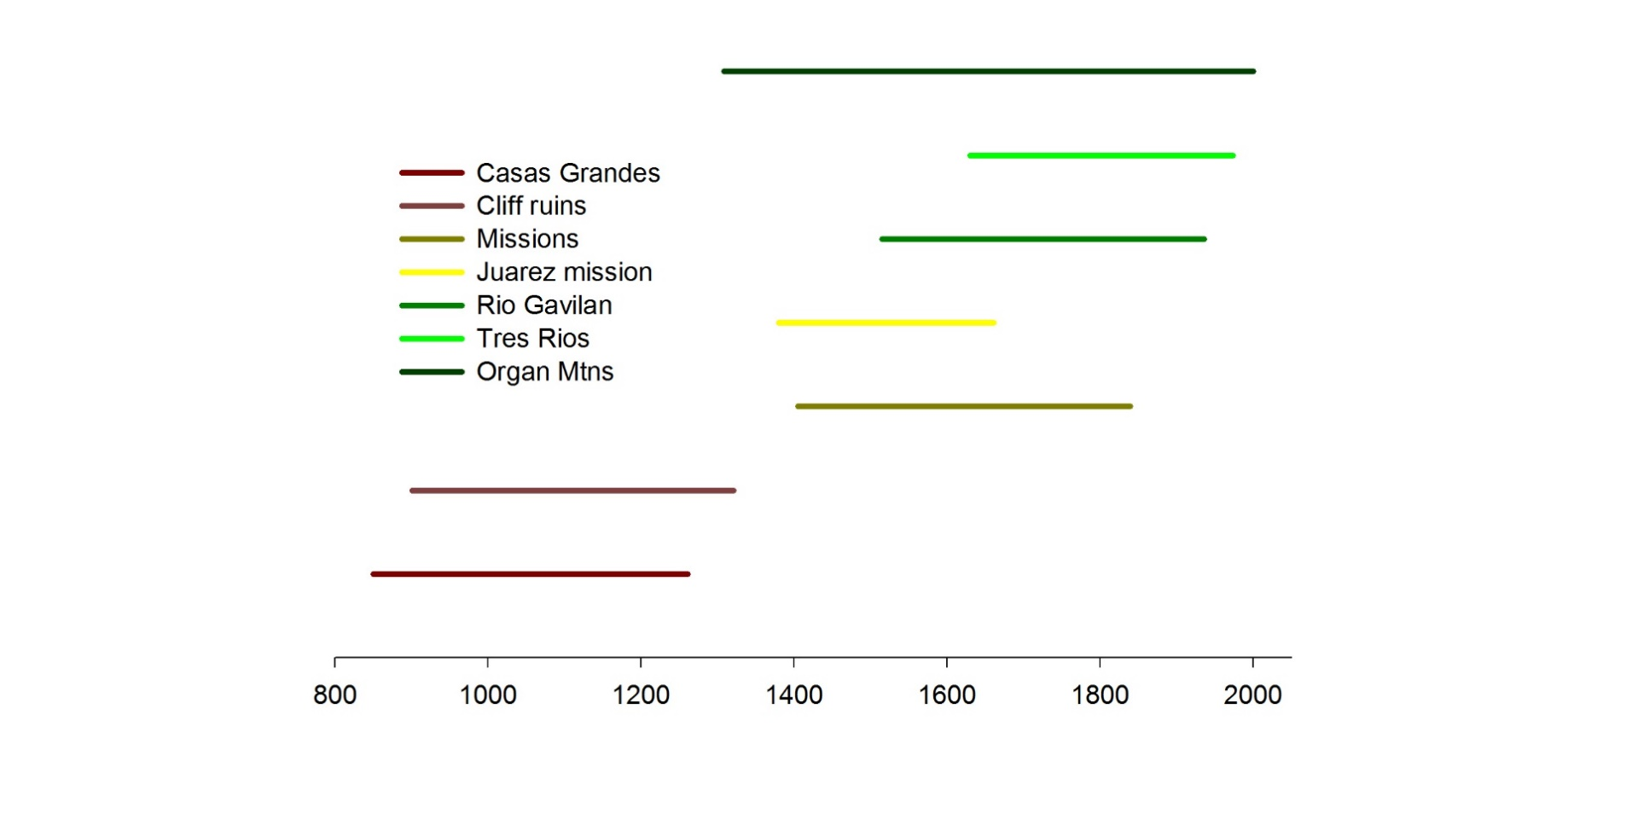
(Las Cruces)
}
Living trees
In Mexico
(El Paso)
~50 sites in Mexico
~20 sites in Mexico

Slide 23
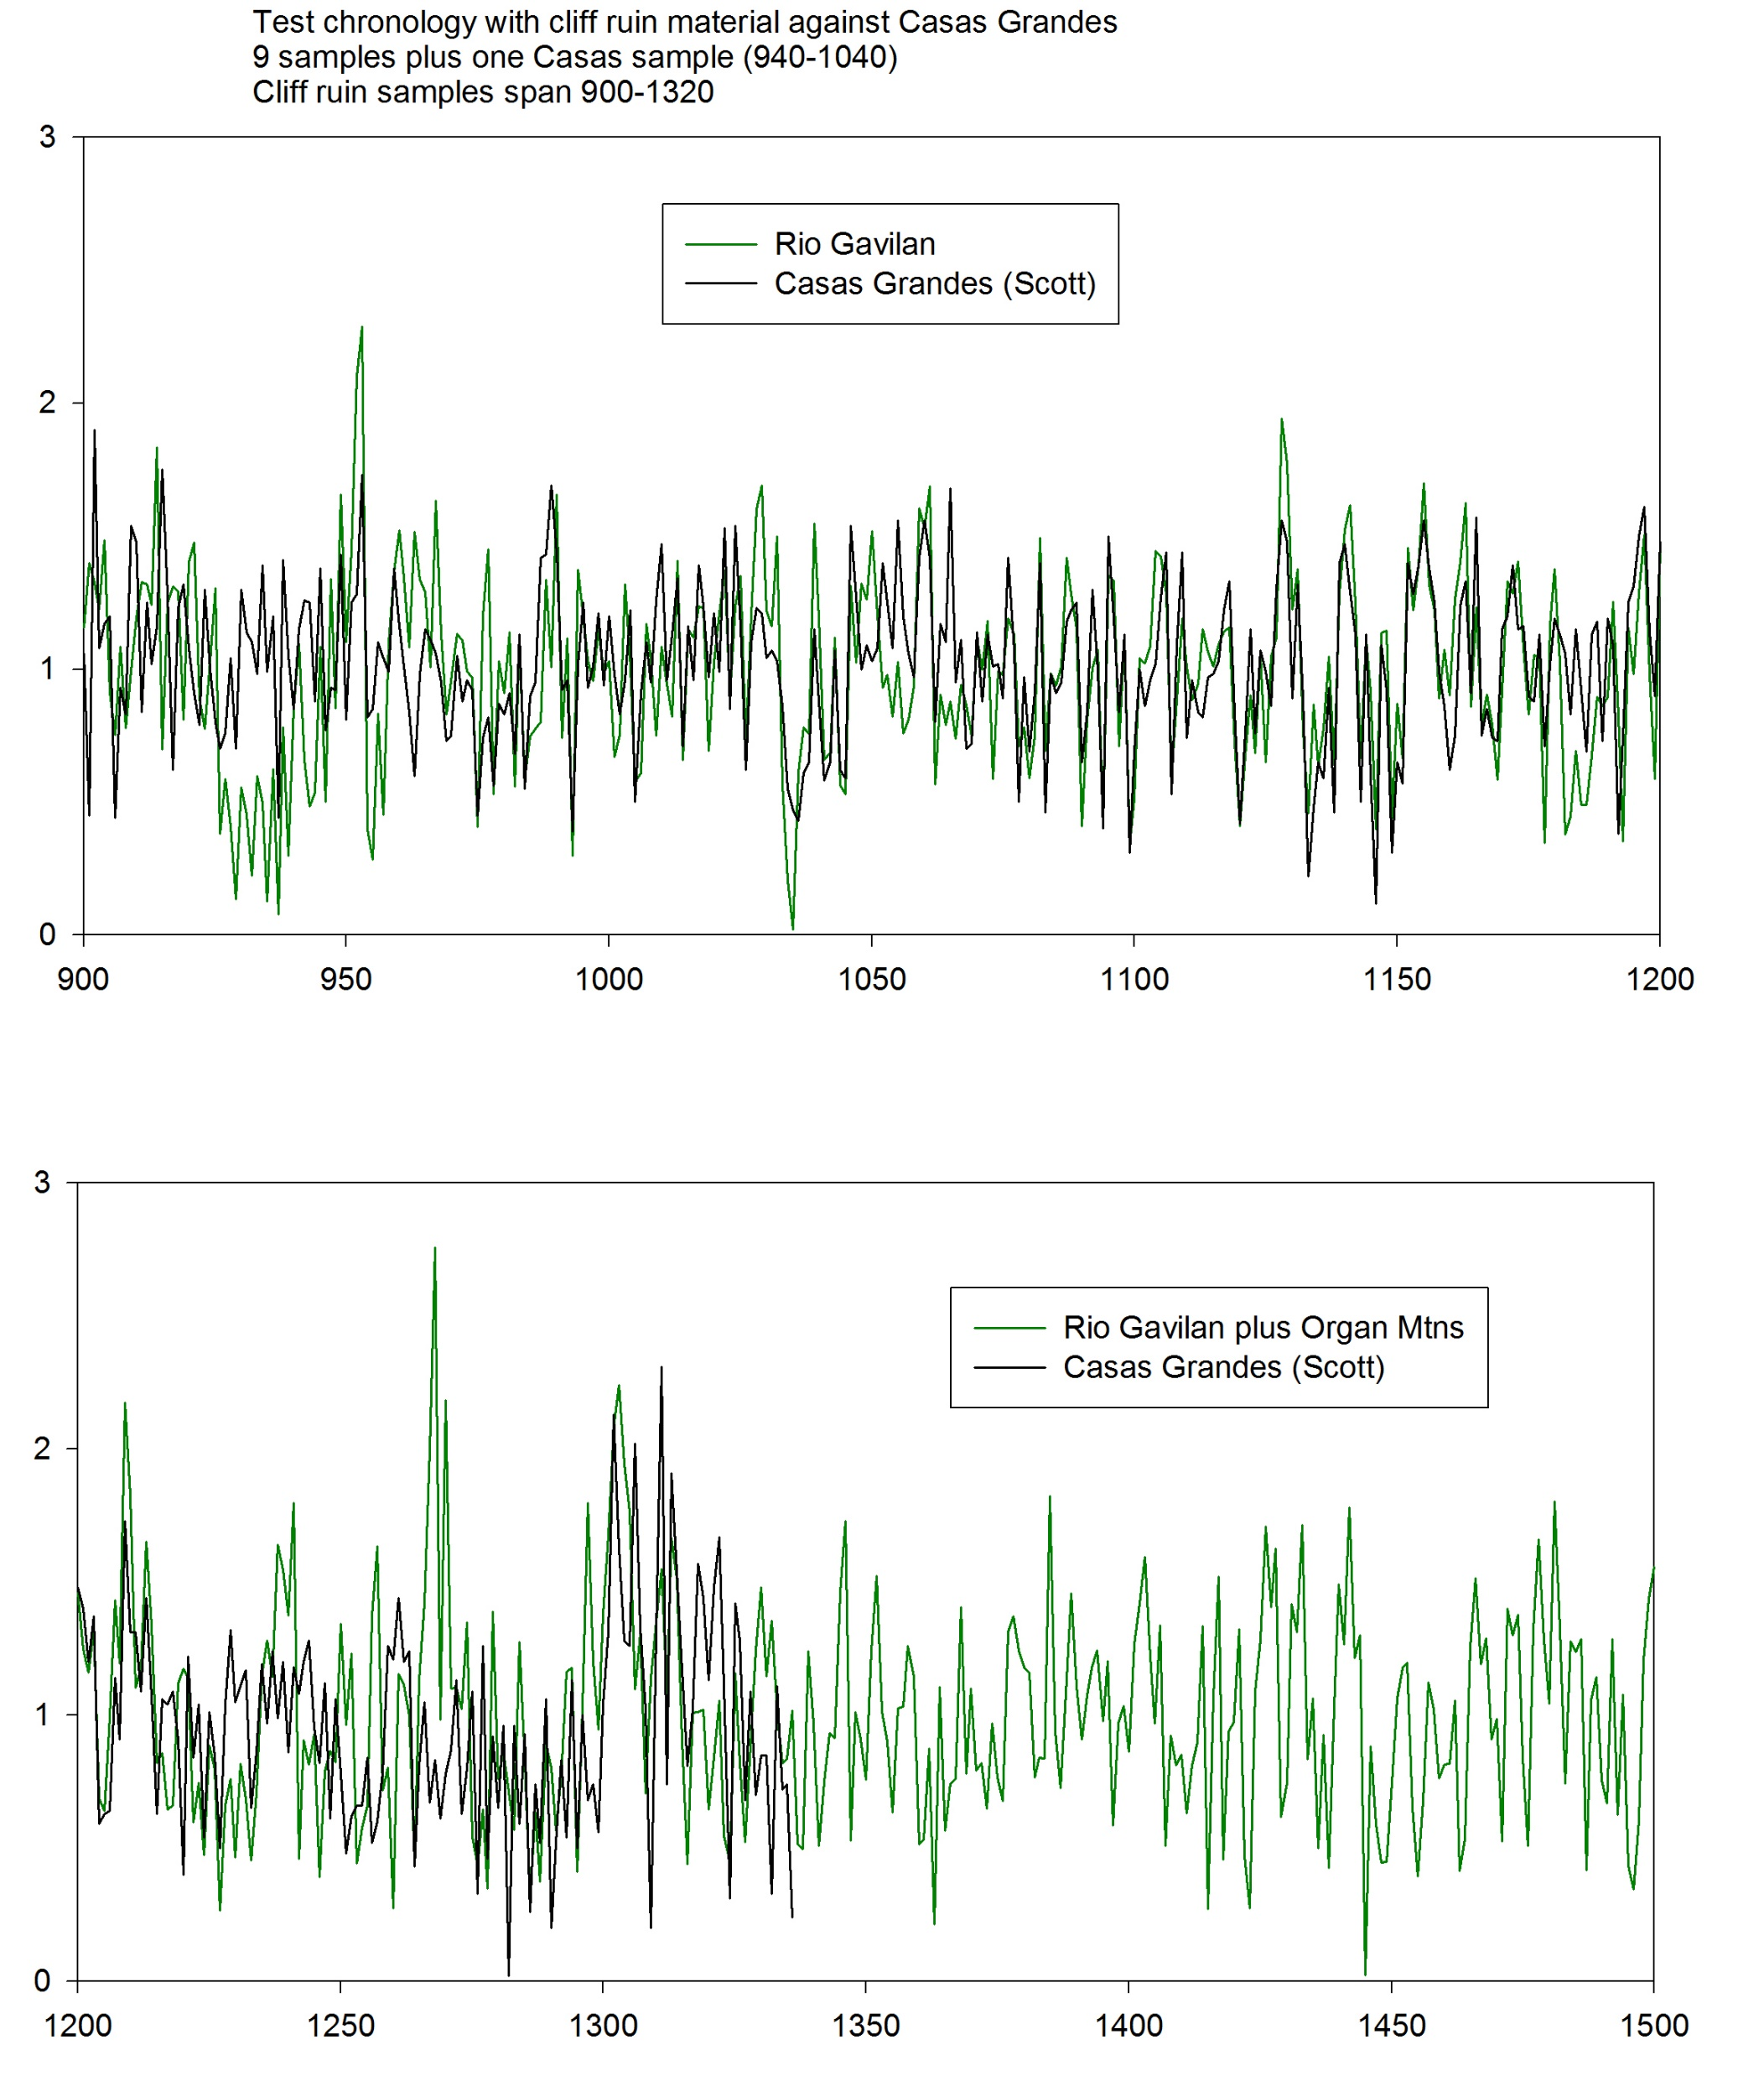

Slide 24
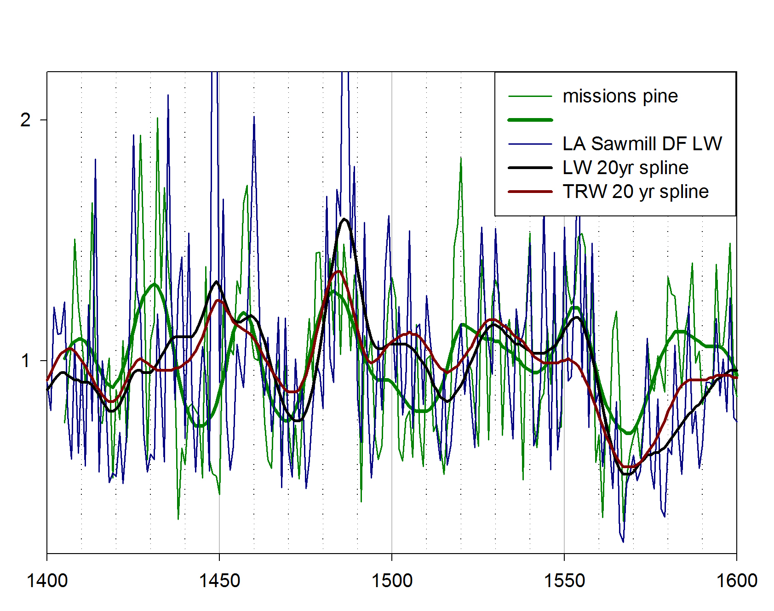
Comparison of missions pine and Los Angeles Sawmill douglas-fir total ring-width and latewood width.
20 yr spline

Slide 25
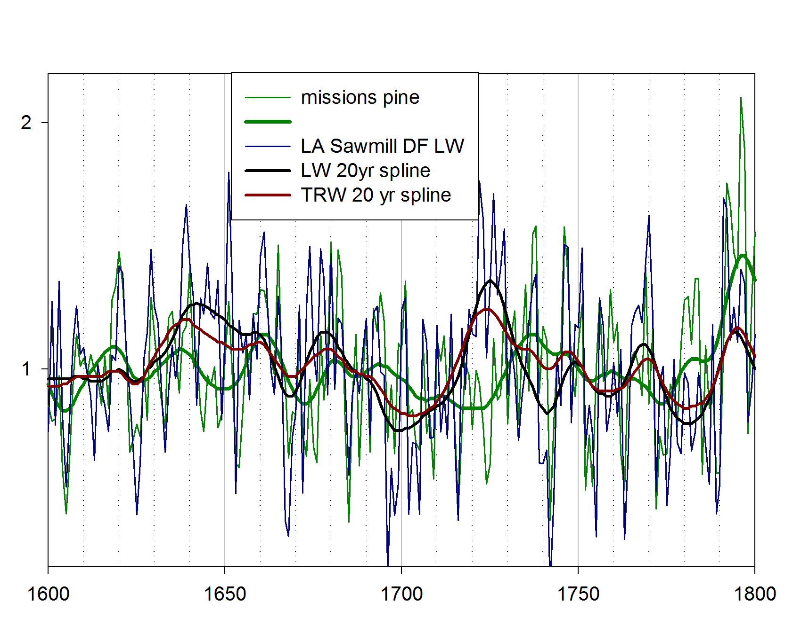
Comparison of missions pine and Los Angeles Sawmill douglas-fir total ring-width and latewood width.
While there is good high-frequency cross-dating
there are differences in the low frequency signal.
Some of this difference will be due to the longer
growing season of the pines vs douglas-fir.
20 yr spline

Slide 26
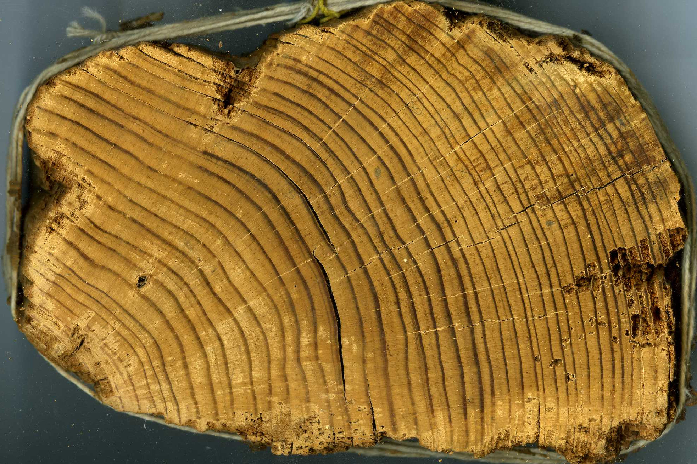
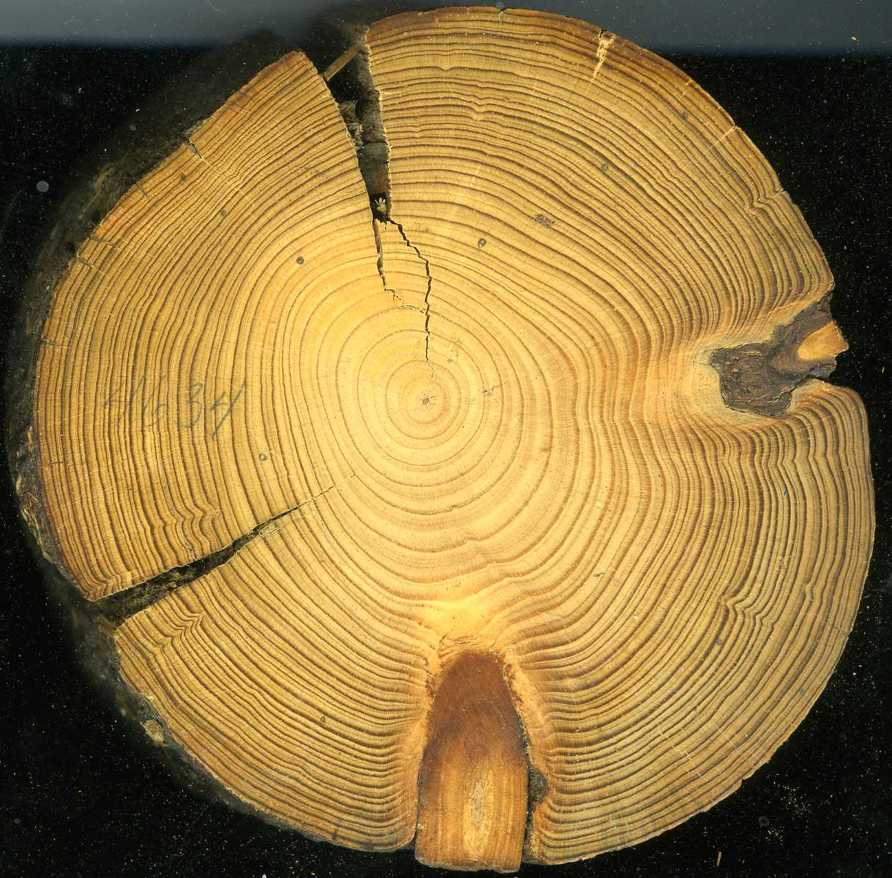
One of the remaining problems with the archaeological samples is that many of samples with a good, clear cutting date have too few rings to be reliably dated using dendrochronological pattern matching alone.
This problem can be overcome by obtaining one or several radiocarbon dates and matching these
to the radiocarbon calibration curve to rule out spurious pattern matches.

Slide 27
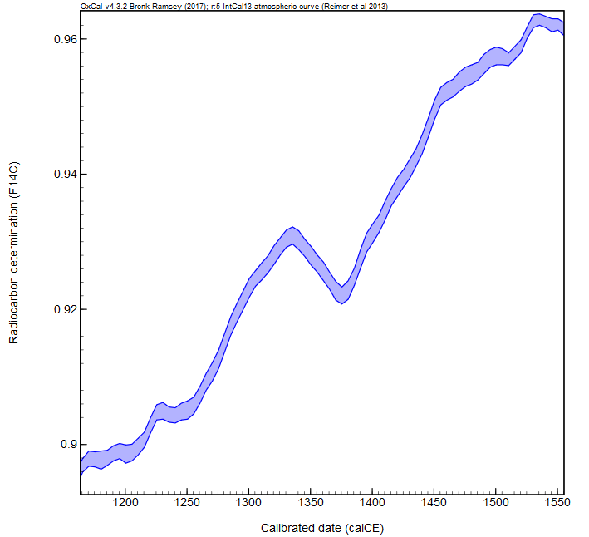
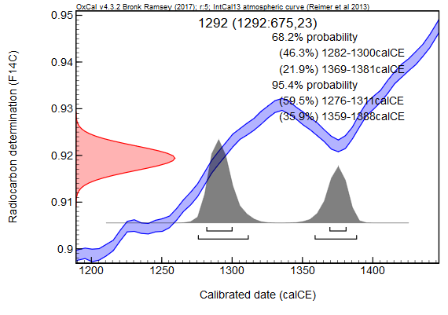
Radiocarbon calibration curve and a simulation of dating a Casas Grandes sample.

Slide 28
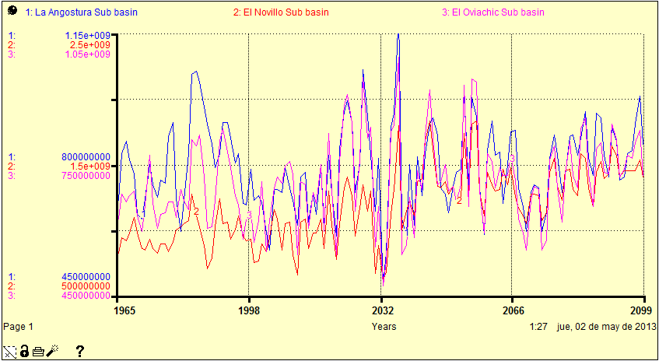
From: Use of Stella Software for the Modelling of Climate Change Impacts on Water Balance
for the Rio Yaqui Basin, Sonora, Mexico by Elia Tepia et. Al. 2014
An example of future projections based on current data

Slide 29
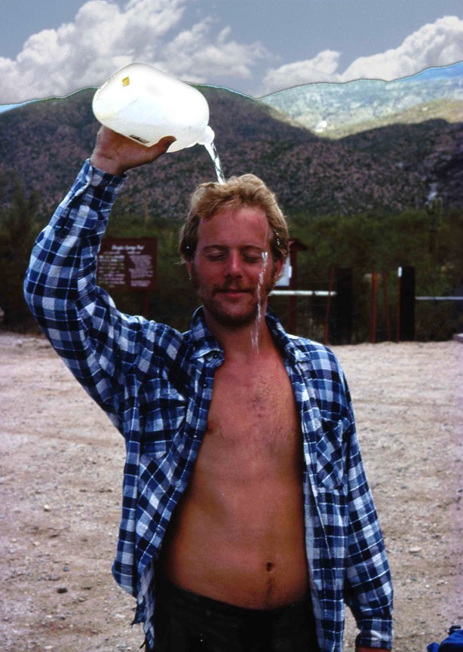
So, what do we have and where (lets look at a map), and
How can we put this data to work looking at some real-world issues?
[put together an interdisciplinary proposal centered on water as a limiting and enabling resource]

Slide 30
